Slide 1

CSE2004 DBMS
Flight Ticket Reservation System
(Review-1)
Team Members
Adarsh Kumar Dubey – 20BCE1422
Saptajit Banerjee – 20BCE1513
Ujjwal Kanti Pramanick – 20BCE1714

Slide 2
Title
Objective
Drawback Existing System
Need Of DBMS In Project
Modules
ER Diagram
Software & Hardware Requirements
References

Slide 3
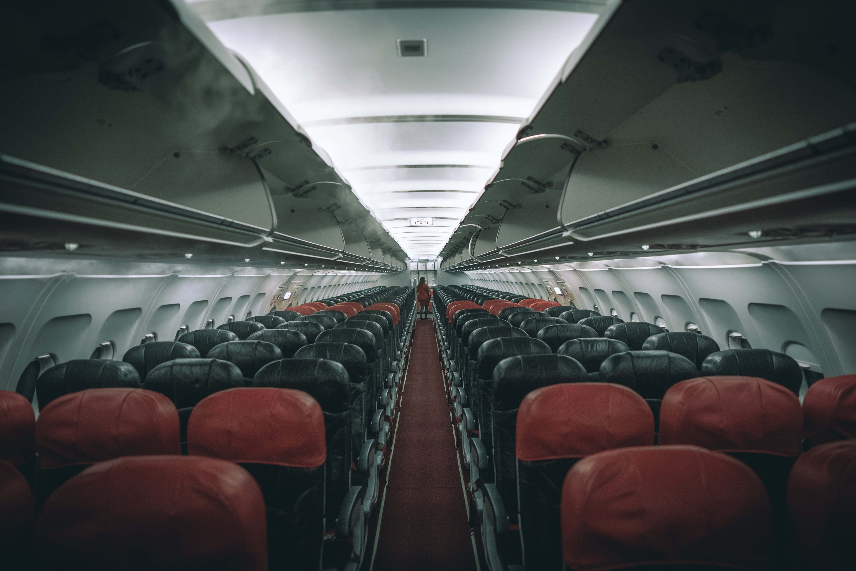
Objective
Though many people travel in airlines but many of them don’t know how to book tickets online so they go to cyber café and have to pay some extra commission to that café owner. They may share many personal details like aadhar number, bank account no, etc which can be misused by that cybercafe owner and he may become a victim of cybercrime.
So, a user-friendly interface should be used which will be very easy for customers so that he/she can book his/her ticket without sharing details with any third person.

Slide 4
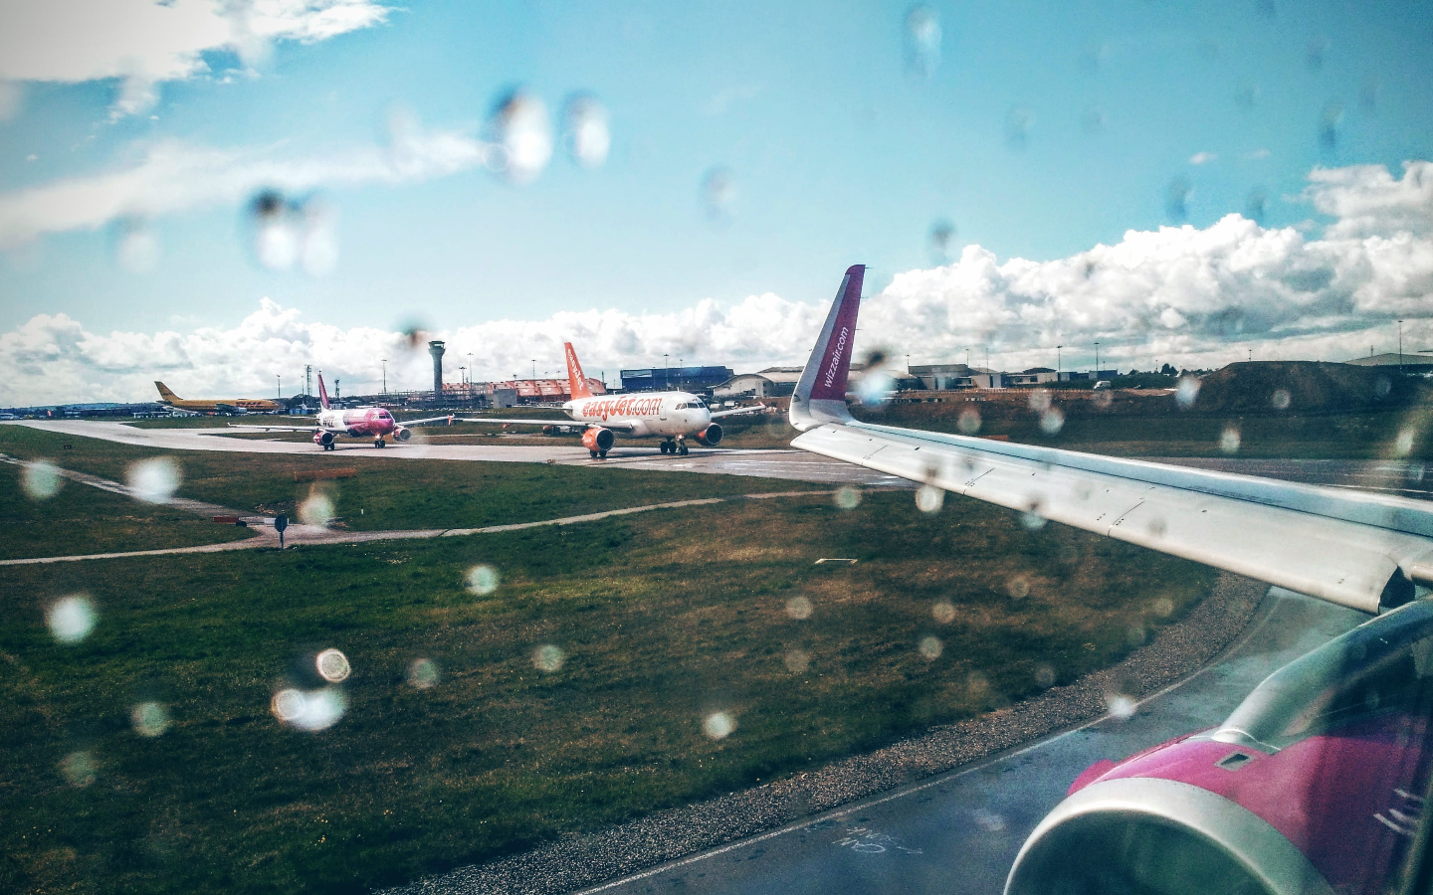
Drawback Of Existing System
The file-based system is apparently used for the management of airlines. This system is more efficient than paper work-based systems but it still has many drawbacks. Some of the major drawbacks are:
Data Redundancy: It is possible that some information could have been duplicated in different files leading to memory wastage.
Data inconsistency: Because of Data Redundancy it is possible that data may not be available in an inconsistent state.
Limited Data Sharing: Data are scattered in different files and many files have different formats and are stored in different locations leading to data isolation making it difficult to share data for different applications.
Difficulty in Accessing Data: Accessing of data is not convenient and efficient in this system
Security Problems: The database based on the File system has poor data security and cannot limit the access of data to the user.
The paper based systems are very inefficient for modern day applications as they lack automation for entry and accessibility of data.

Slide 5

Need Of DBMS
As we are dealing with lot of information of many customers, so we have to store all that information at a place where those information will be secure and easily accessible to authority.
For this purpose, a Data Base Management(DBMS) system is required which will run with the backend code and frontend code store all the data from the Graphical User Interface(GUI) easily.
A good Data Base Management(DBMS) system should be chosen so that it can store data and operate with other systems efficiently.
It also should have high security so that data cannot be stolen by any third party and give limited access of data to its users.

Slide 6
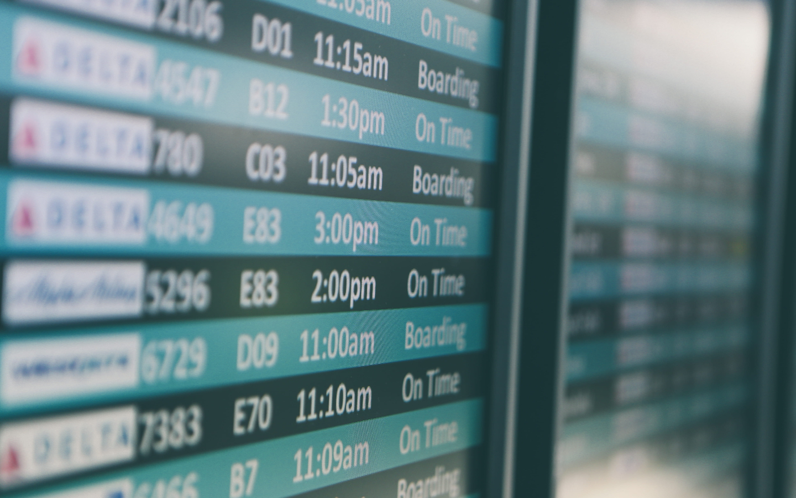
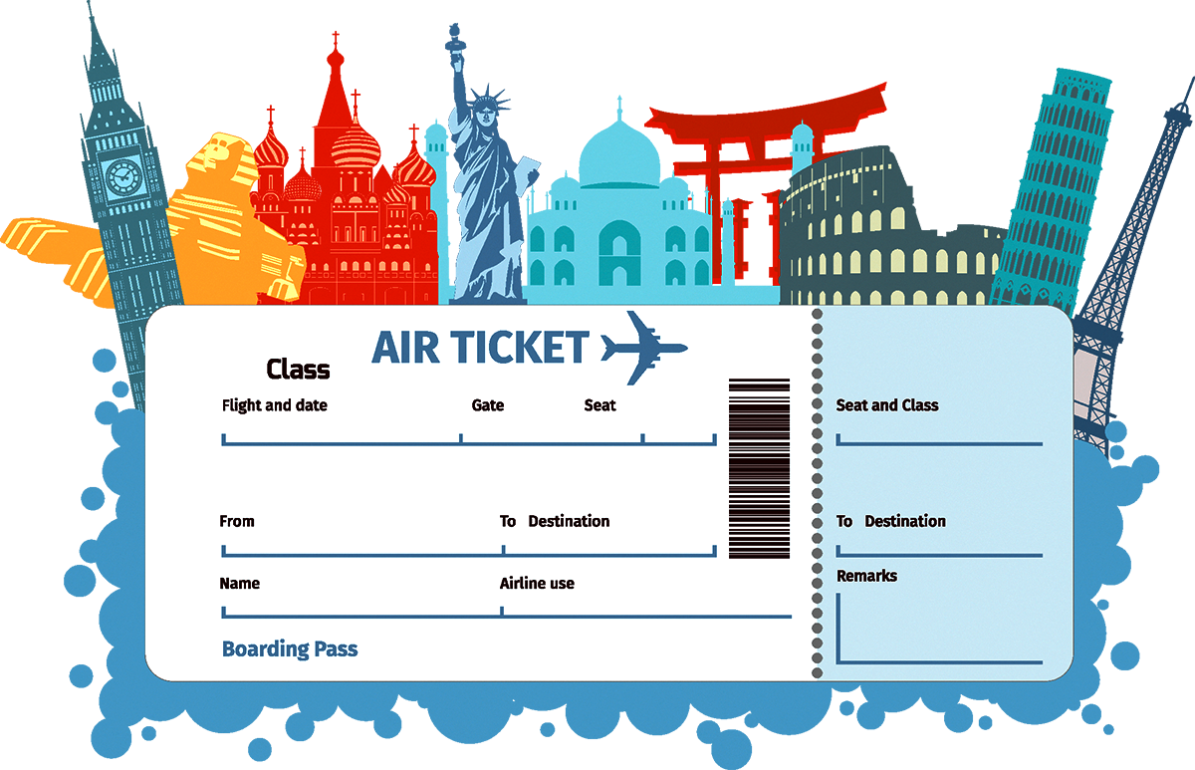
Modules
User
Admin
Tickets
Airlines
Staff

Slide 7

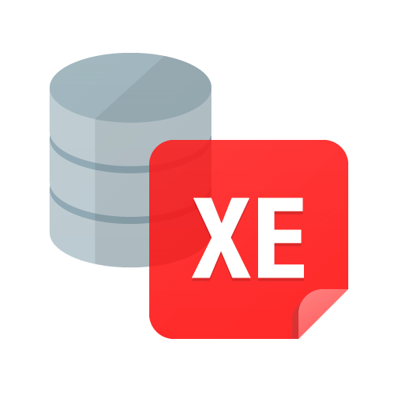

Software & Hardware Requirements
Python 3.8+ or 3.9+
Tkinter
Oracle SQL (Express Edition)
Ram: 1Gb
Hard Disk Free Space: 5Gb

Slide 8
ER DIAGRAM
NAME
USER
EMAIL
DESTINATION
TICKET_ID
SEAT NO
LOGIN ID
1
ADHAAR
MOBILE
HAS
1
1
BOOKS
N
Login
Tickets
SOURCE
1
CANCEL
N
PASSWORD
LUGGAGE LIMIT
COMPANY
1
BELONGS TO
N
PRICE
FLIGHT NO
Flights
PASSENGER NAME
N
COUNTRY
RECEIVE
NO OF SEAT
1
Airlines
1
FOR
N
HAS
CITY
1
PILOT
CO PILOT
NAME
NAME
N
ID
ID
Payment
STAFF
N
N
HAS
HAS
Airport
1
TYPE
1
N
PIN
TYPE
NO . AIR HOSTESS
1
CITY
NAME
N
FOOD AVAILABLE
FOR
1
Flight Leg
ARRIVAL & DEPARTURE
RECIEPT NO
1
CARD ID
CLASS
EMPLOYEE
AGE
ITEM NAME
LEG NO
TYPE
EMP ID
JOB
M
SALARY
FARE
1
SERVE
NAME
P_ID
M
BOARDS
N
N
PURCHASE
Passenger
1
N
ORDER
1
MOBILE NO
ADDRESS
COUNTRY

Slide 9
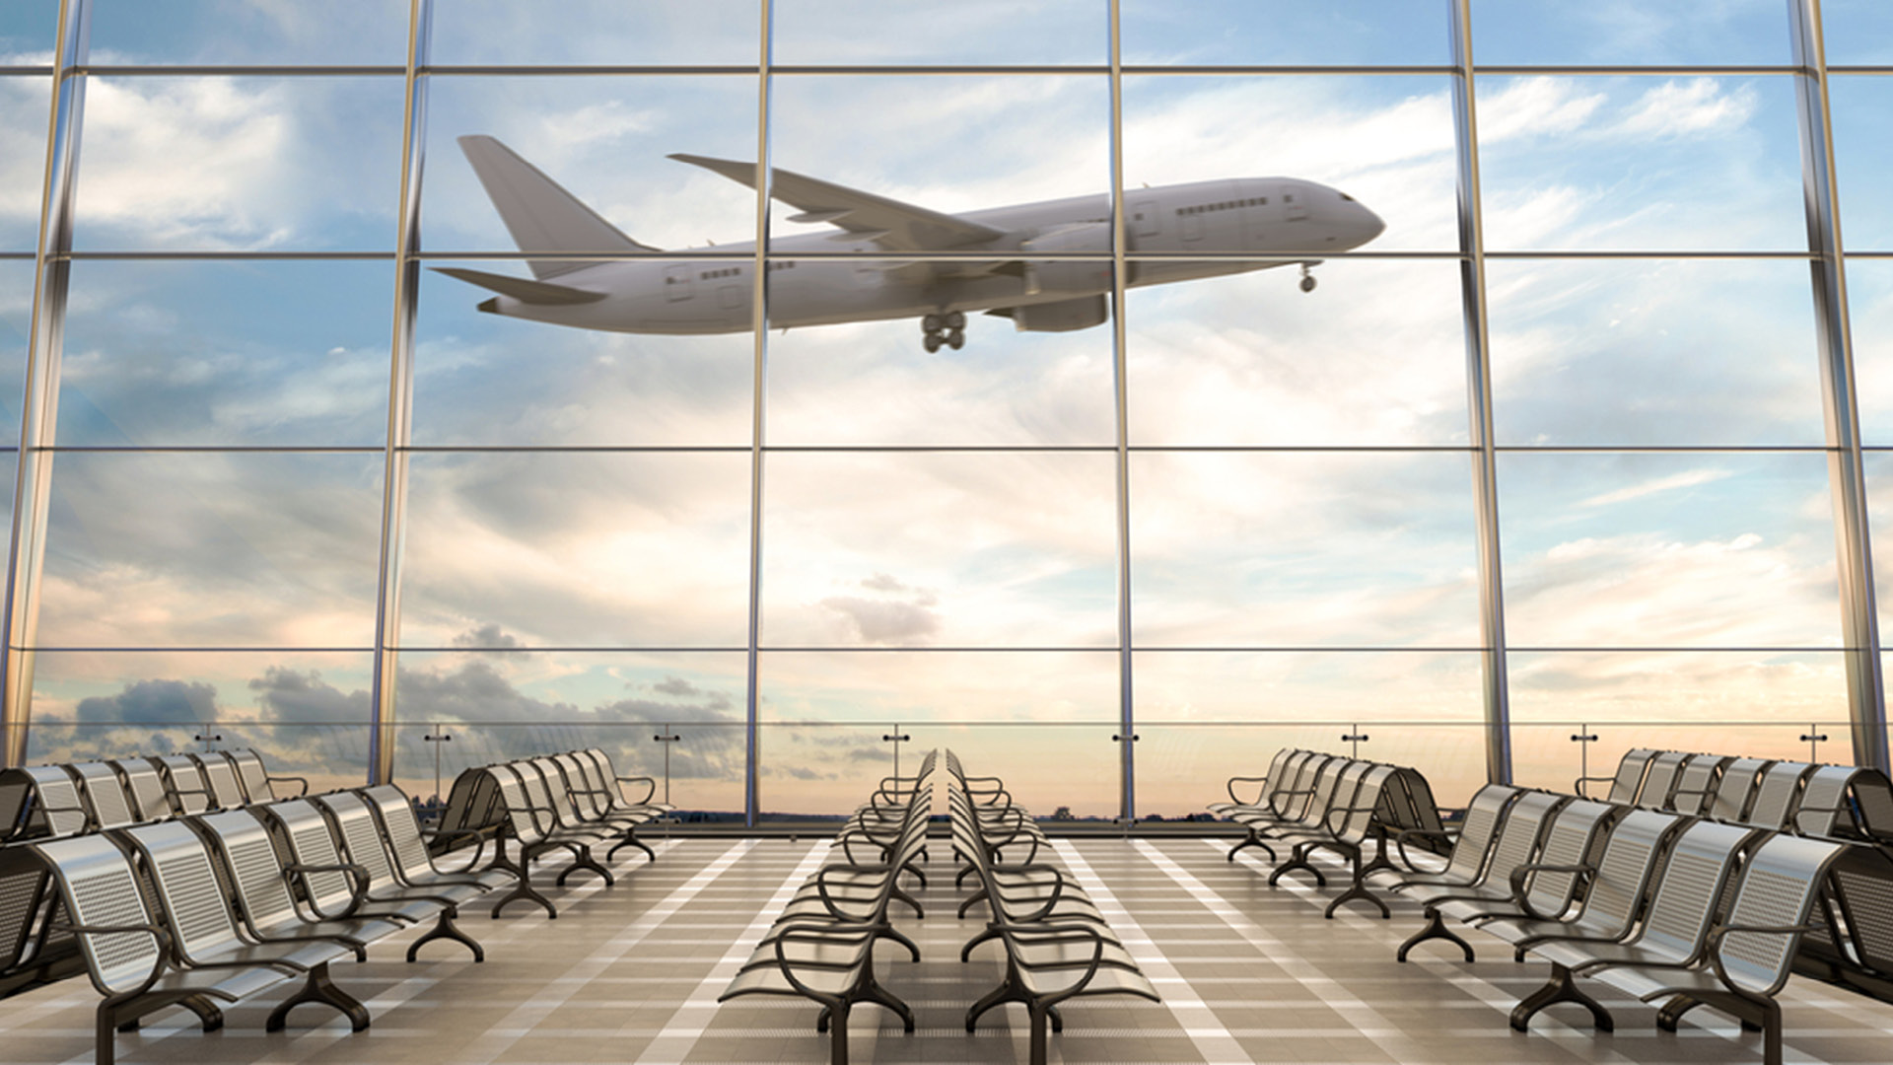
References
https://www.freeprojectz.com/dbms-sql-database-project/airlines-ticket-booking-system-dbms-project
https://www.youtube.com/watch?v=ftPoGO5AvyM&t=427s
https://www.youtube.com/watch?v=d56sf29tSzw
https://www.youtube.com/channel/UCFB0dxMudkws1q8w5NJEAmw
https://www.youtube.com/channel/UCxG8X3oiBsqTKFhrk53AfXw
Fundamentals of Database Systems 7th Edition by Shamkant B. Navathe and Ramez Elmasri

Slide 10
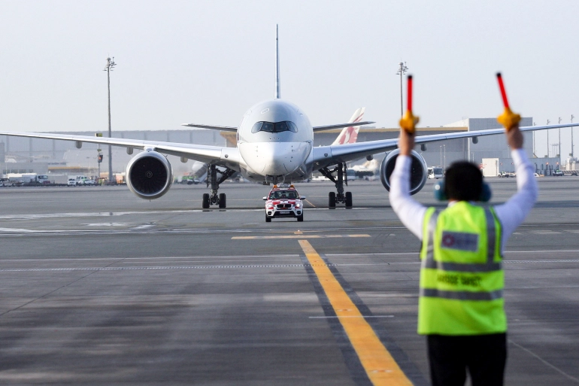
THANK YOU

